Slide 1
Saint Matthew Island Blue King Crab Assessment Sept 2018
James Ianelli and Jie Zheng

Slide 2
Data

Slide 3
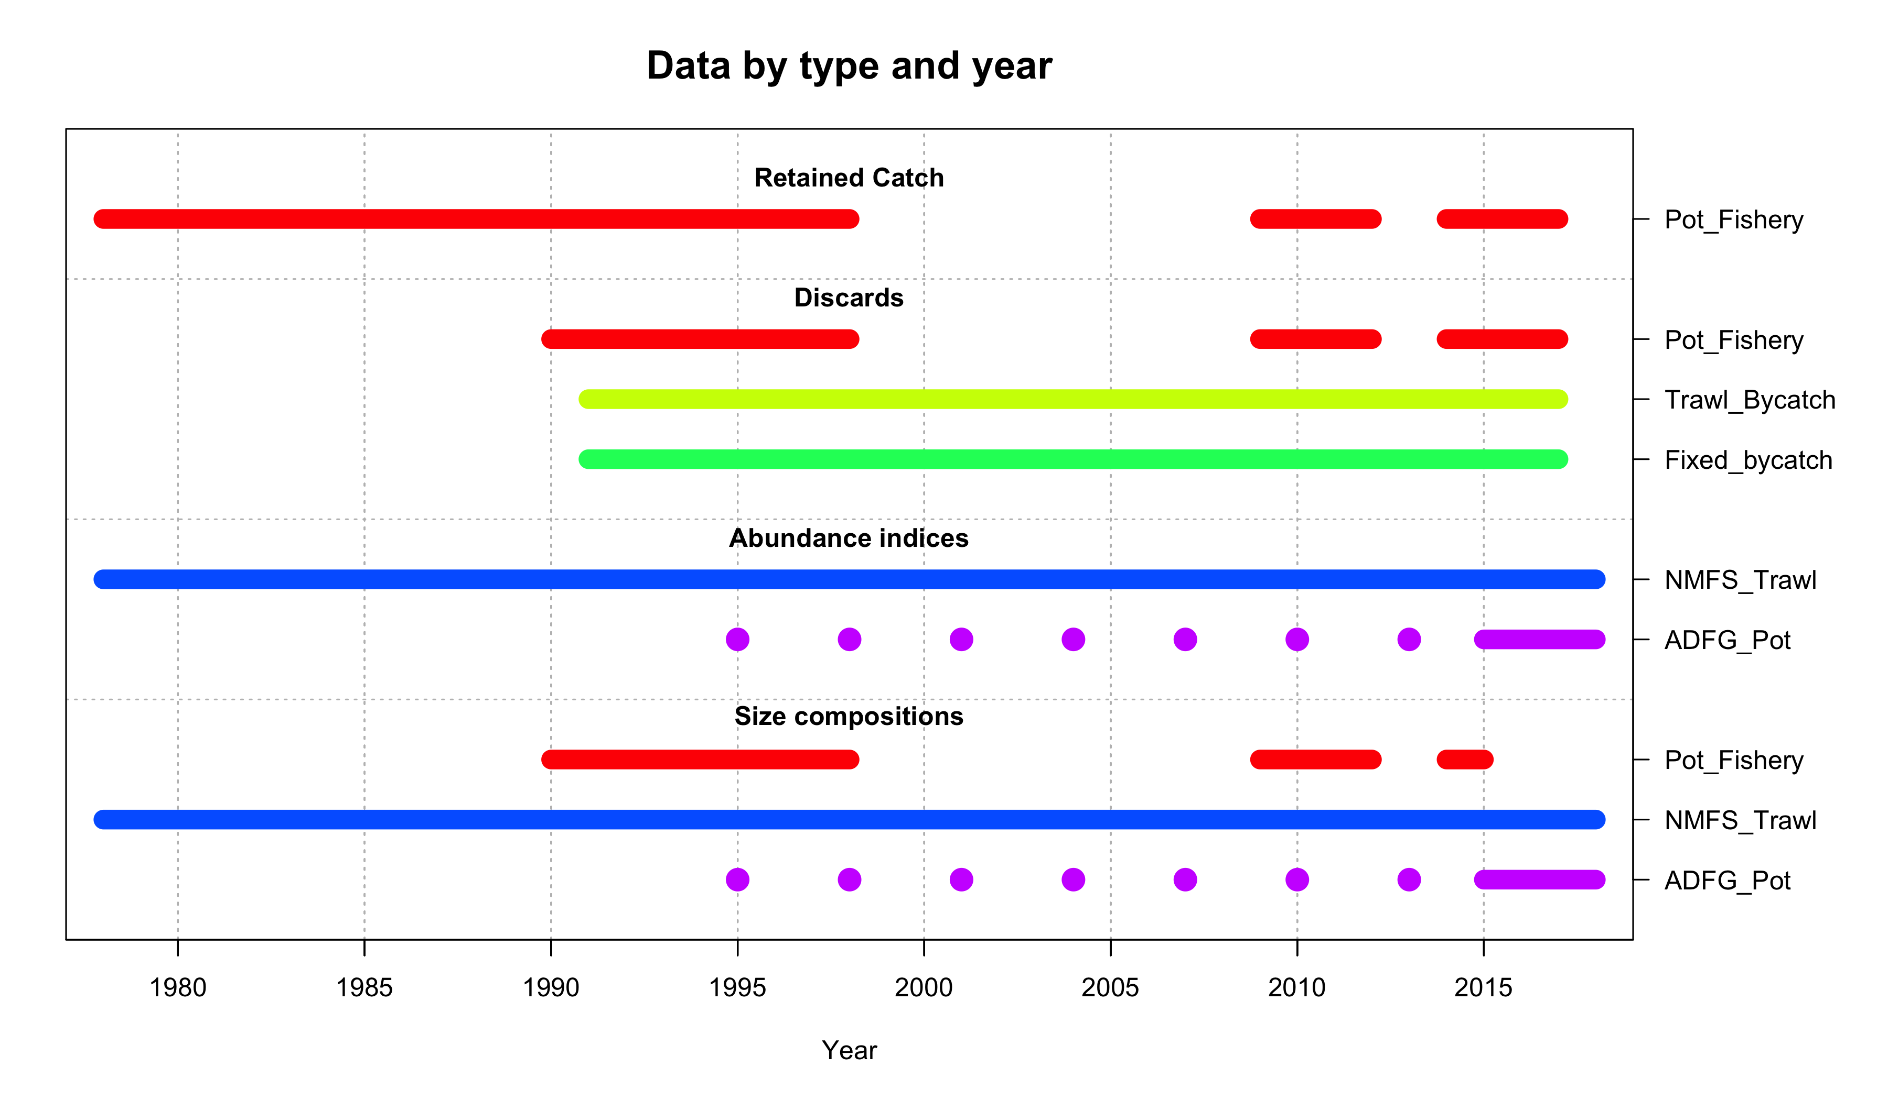
Data

Slide 4
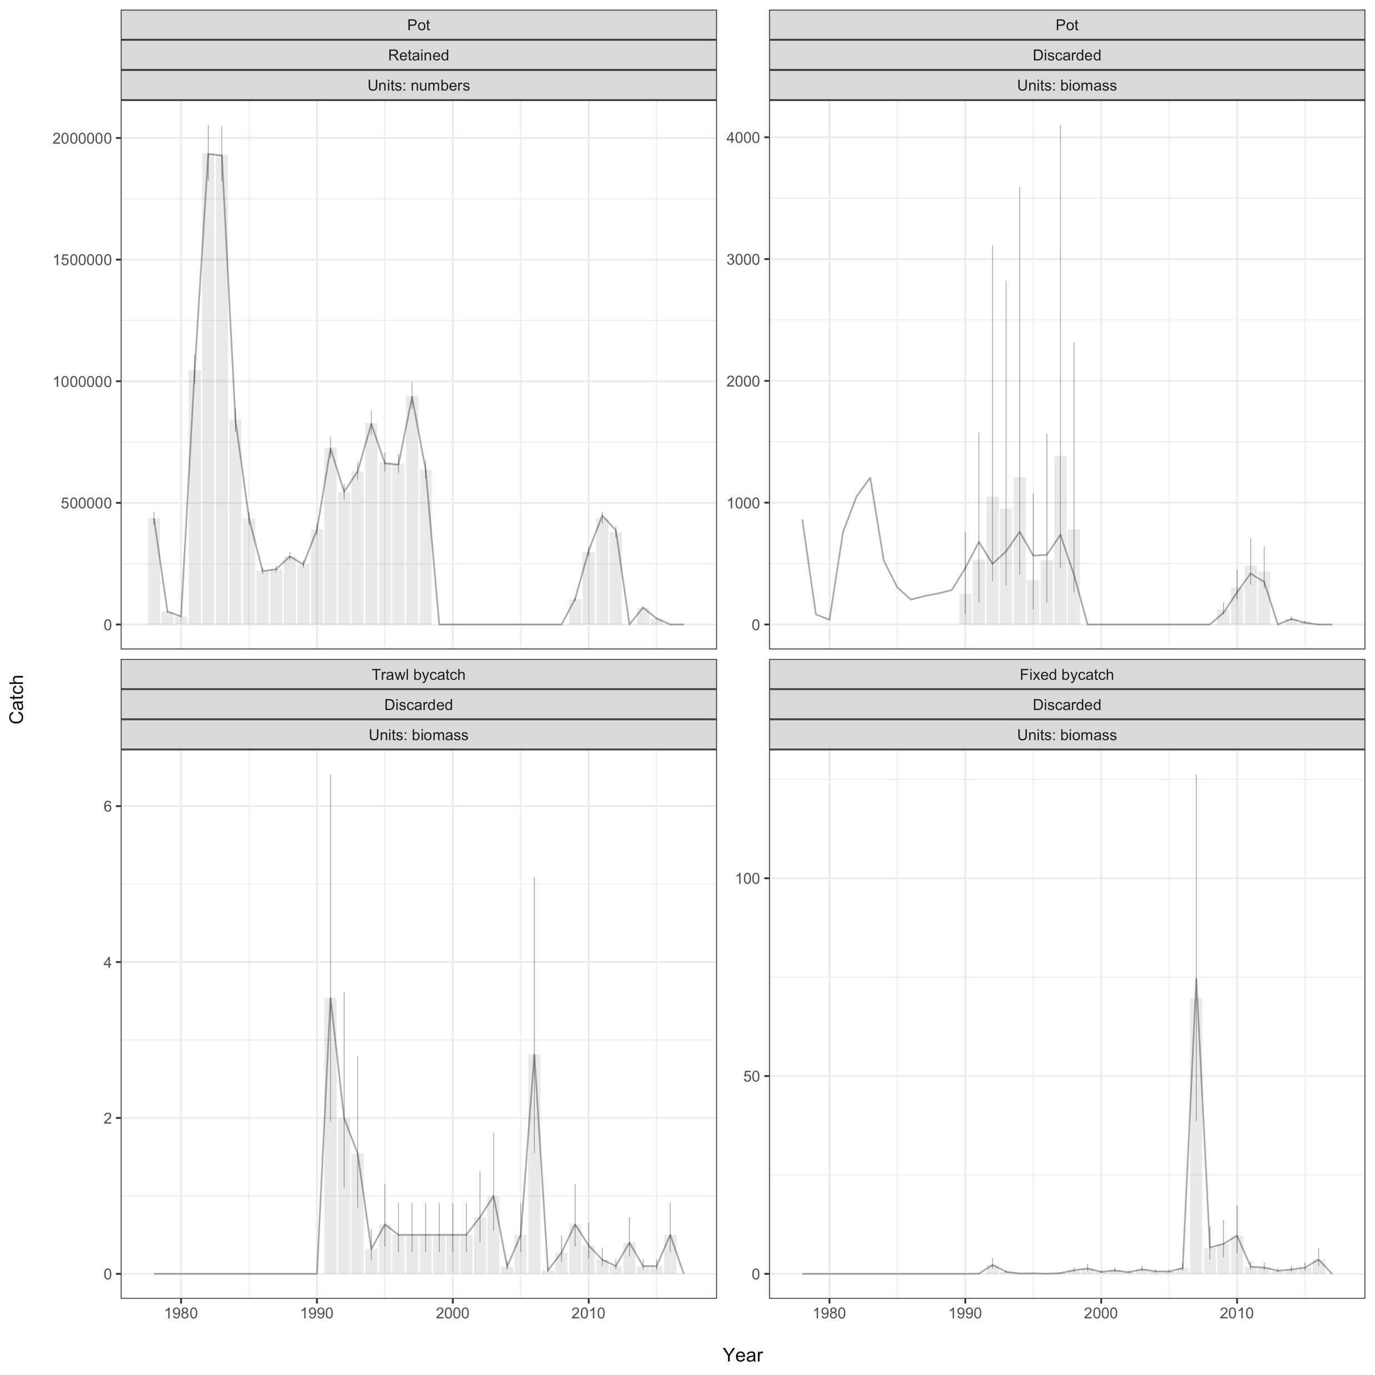

Slide 5
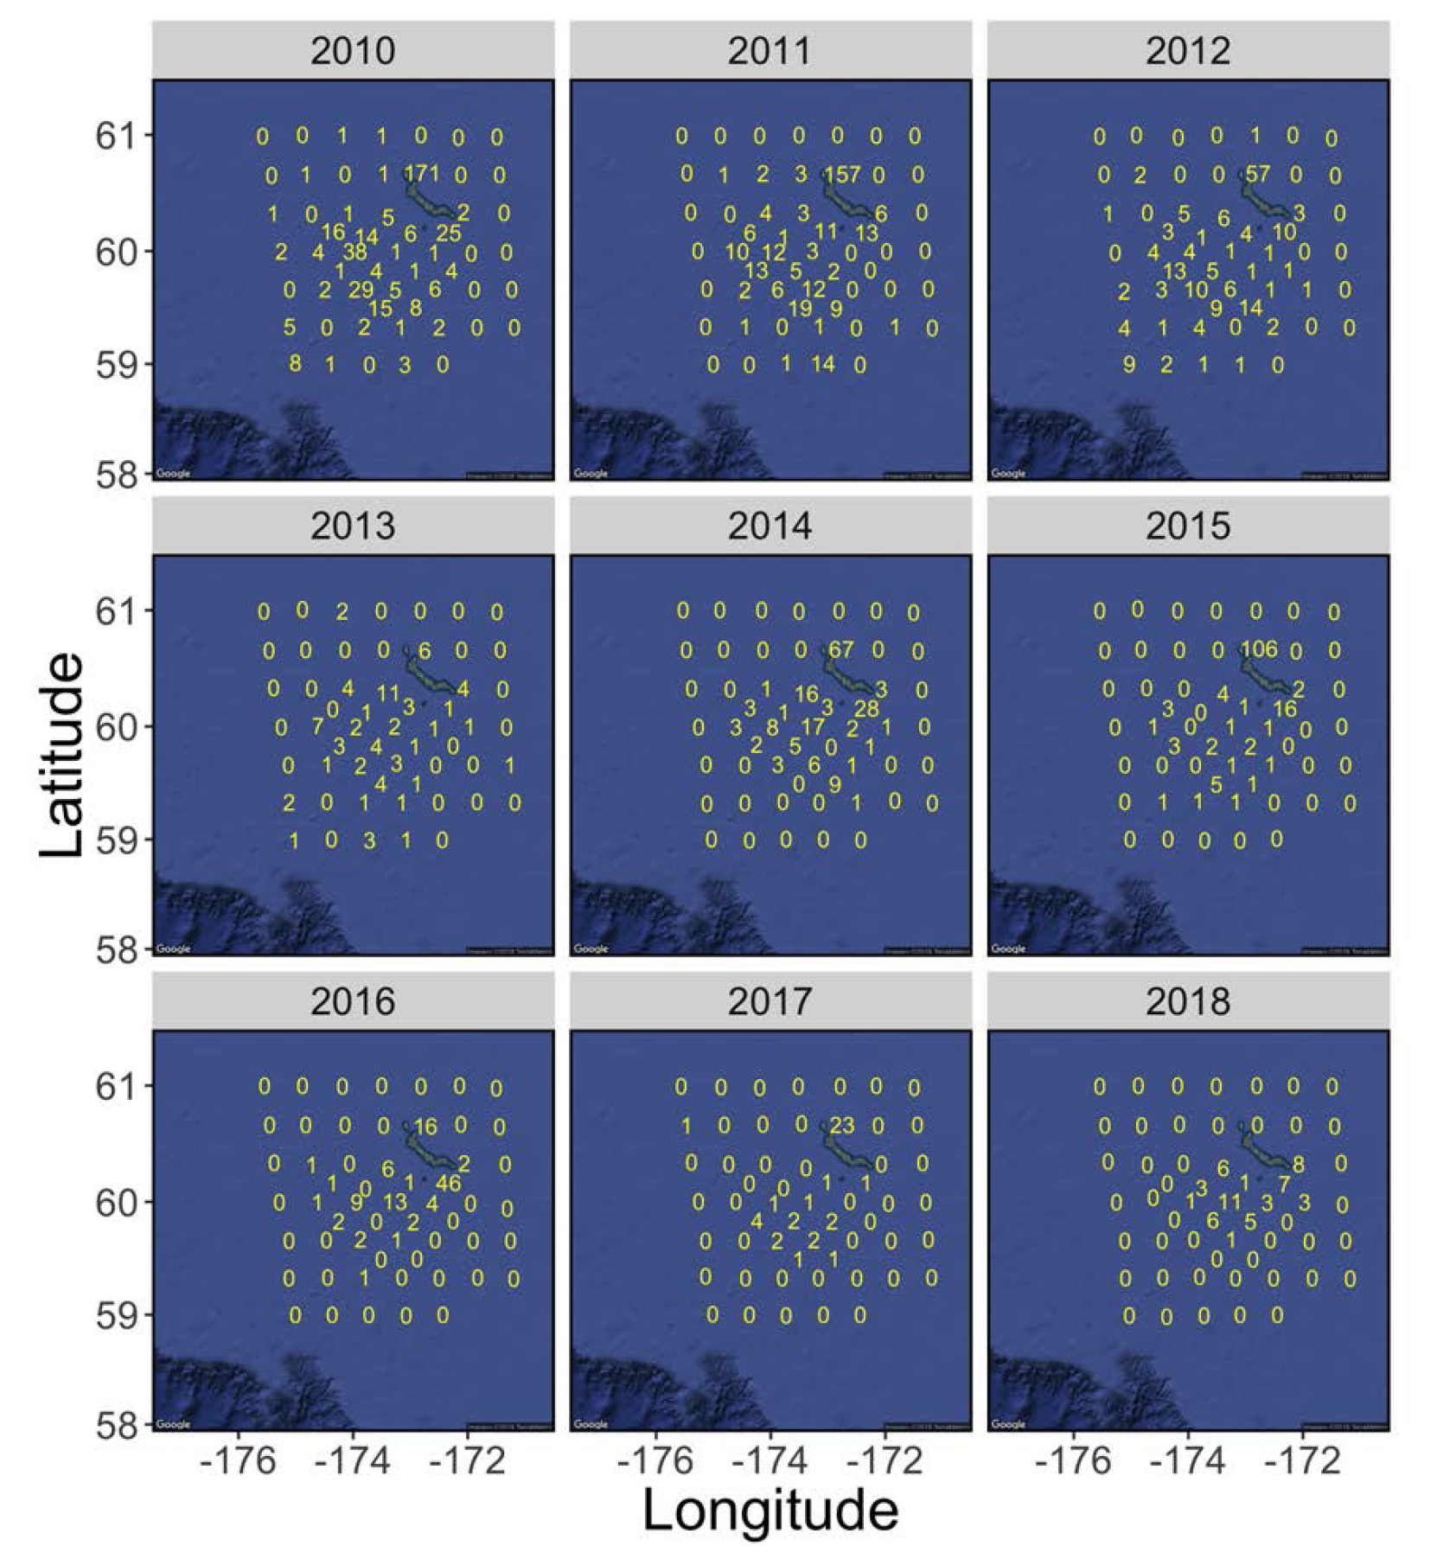
NMFS trawl

Slide 7
SMBKC in Gmacs
1978-2018
5 seasons
3 stages (90-104, 105-119, 120+)
1 sex, 1 shell type, 1 maturity class
3 fleets (pot, trawl bycatch, fixed bycatch)
2 surveys (NMFS trawl and ADF&G pot CPUE) both in season 1
4 catch types (directed pot, pot discards, trawl bycatch, fixed bycatch)
3 size compositions (pot in season 2, NMFS trawl in season 1, ADF&G pot in season 1)

Slide 8
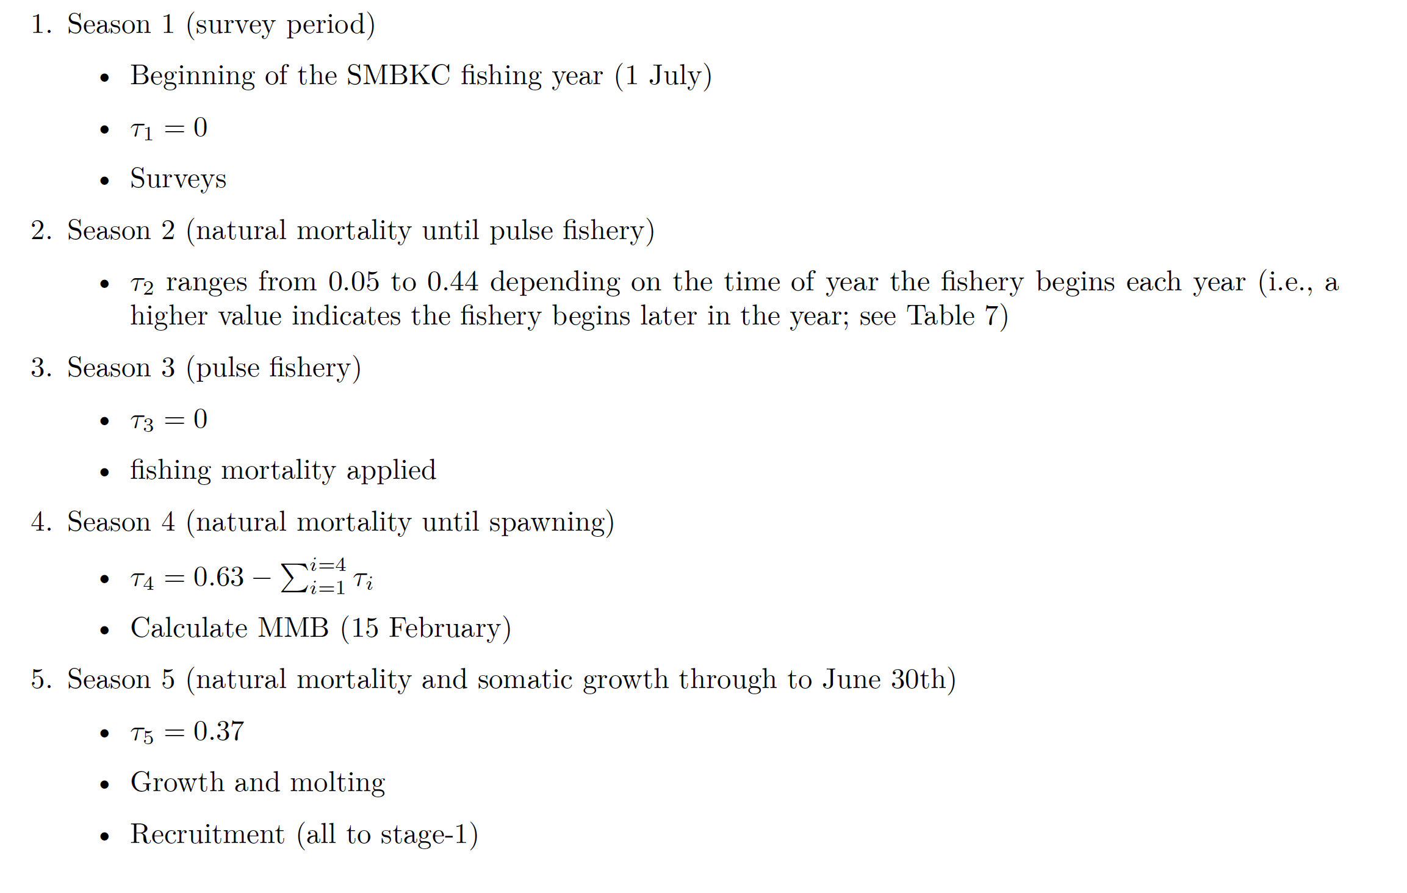
SMBKC dynamics

Slide 9
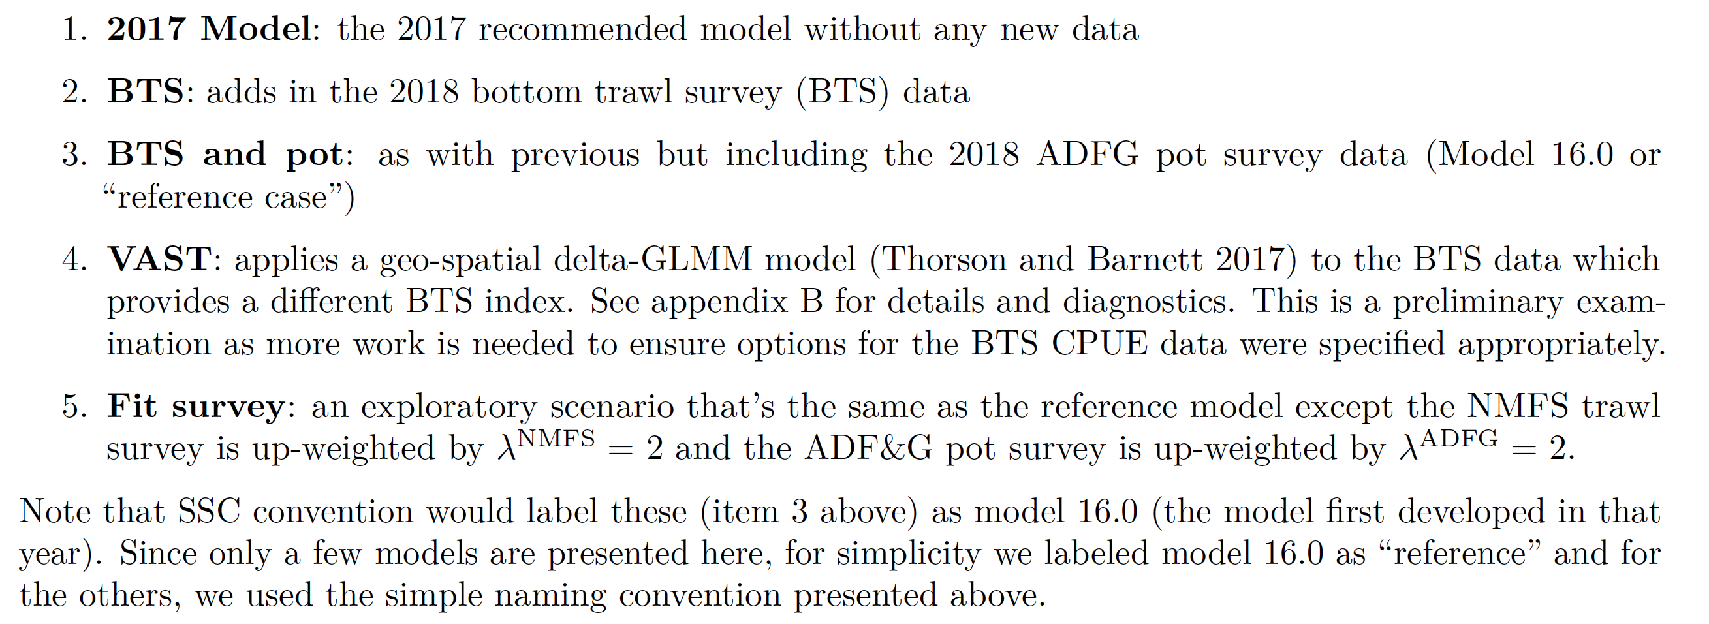
SMBKC Models evaluated

Slide 10
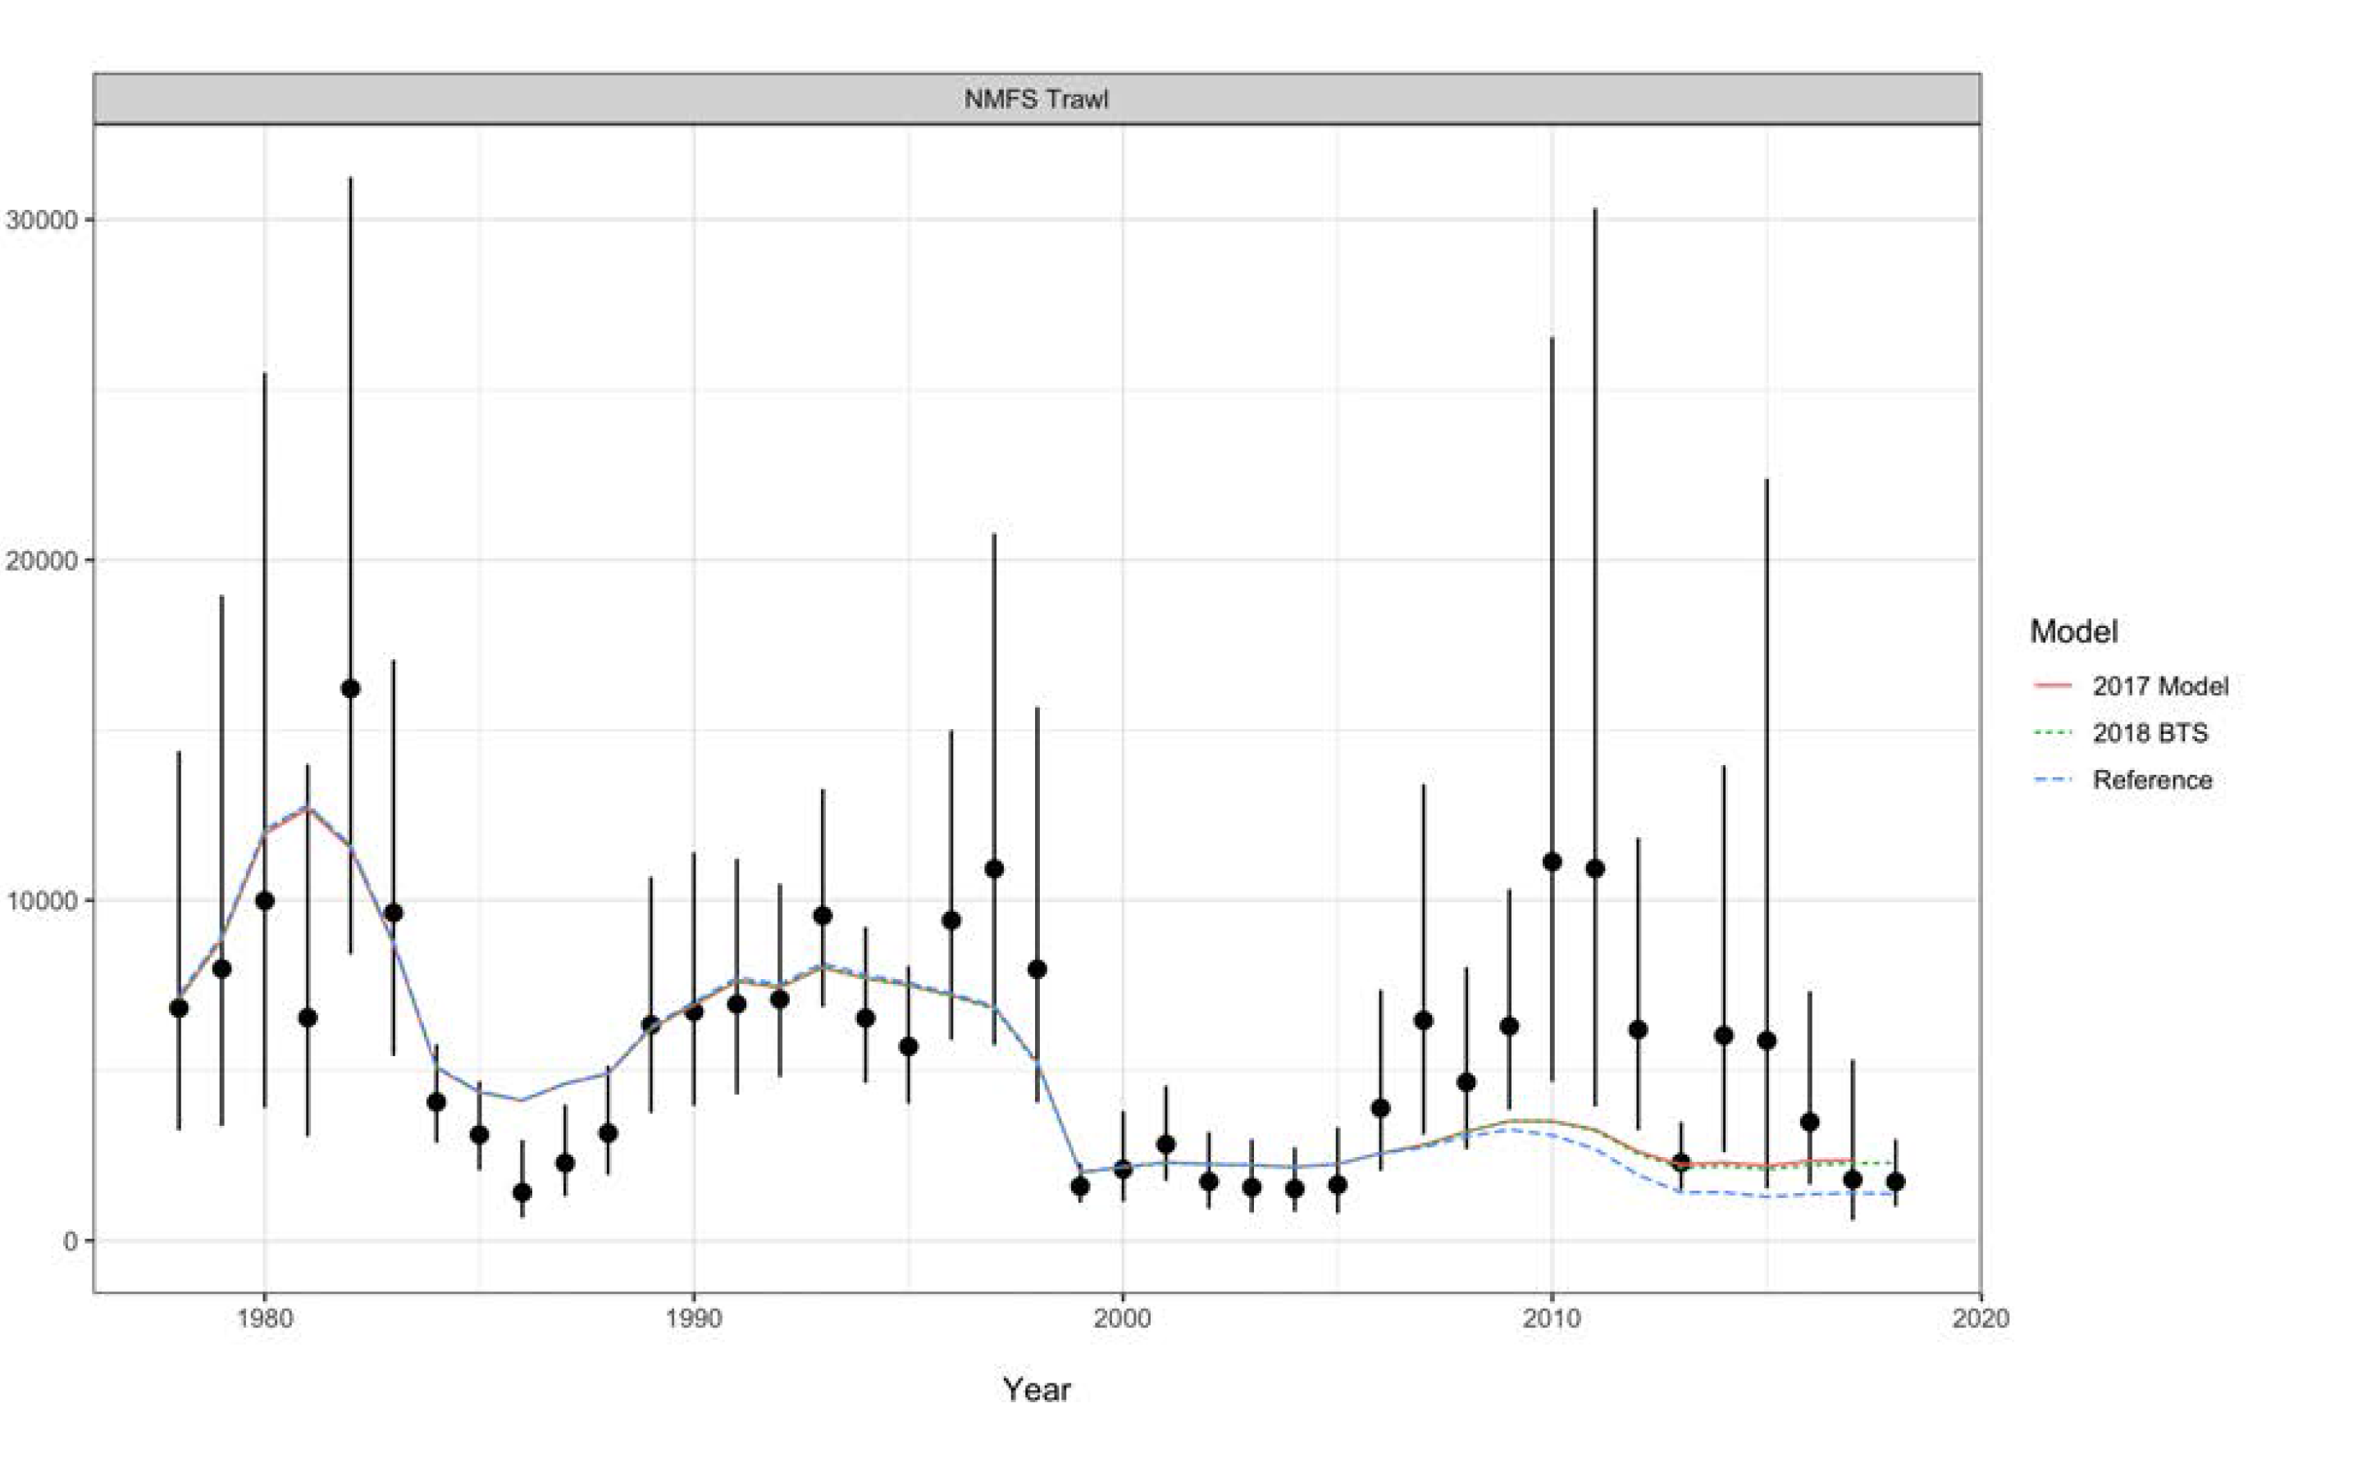
Sensitivity to new data

Slide 11
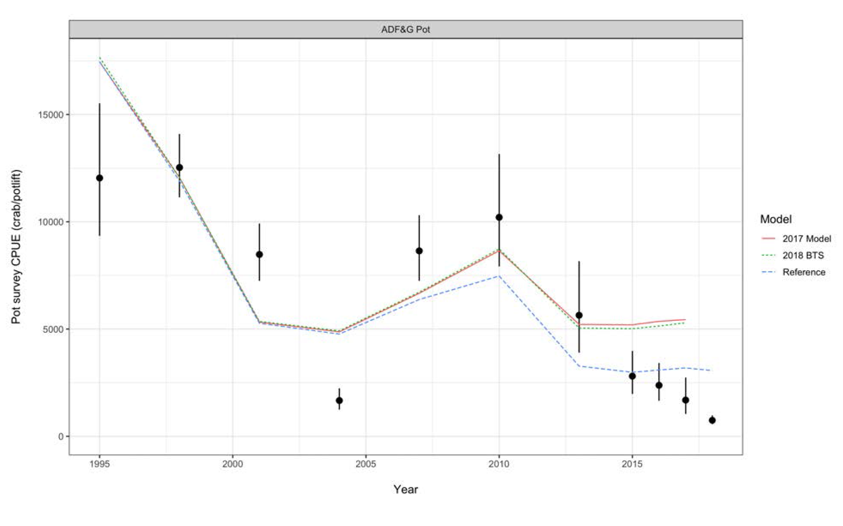
Sensitivity to new data

Slide 12
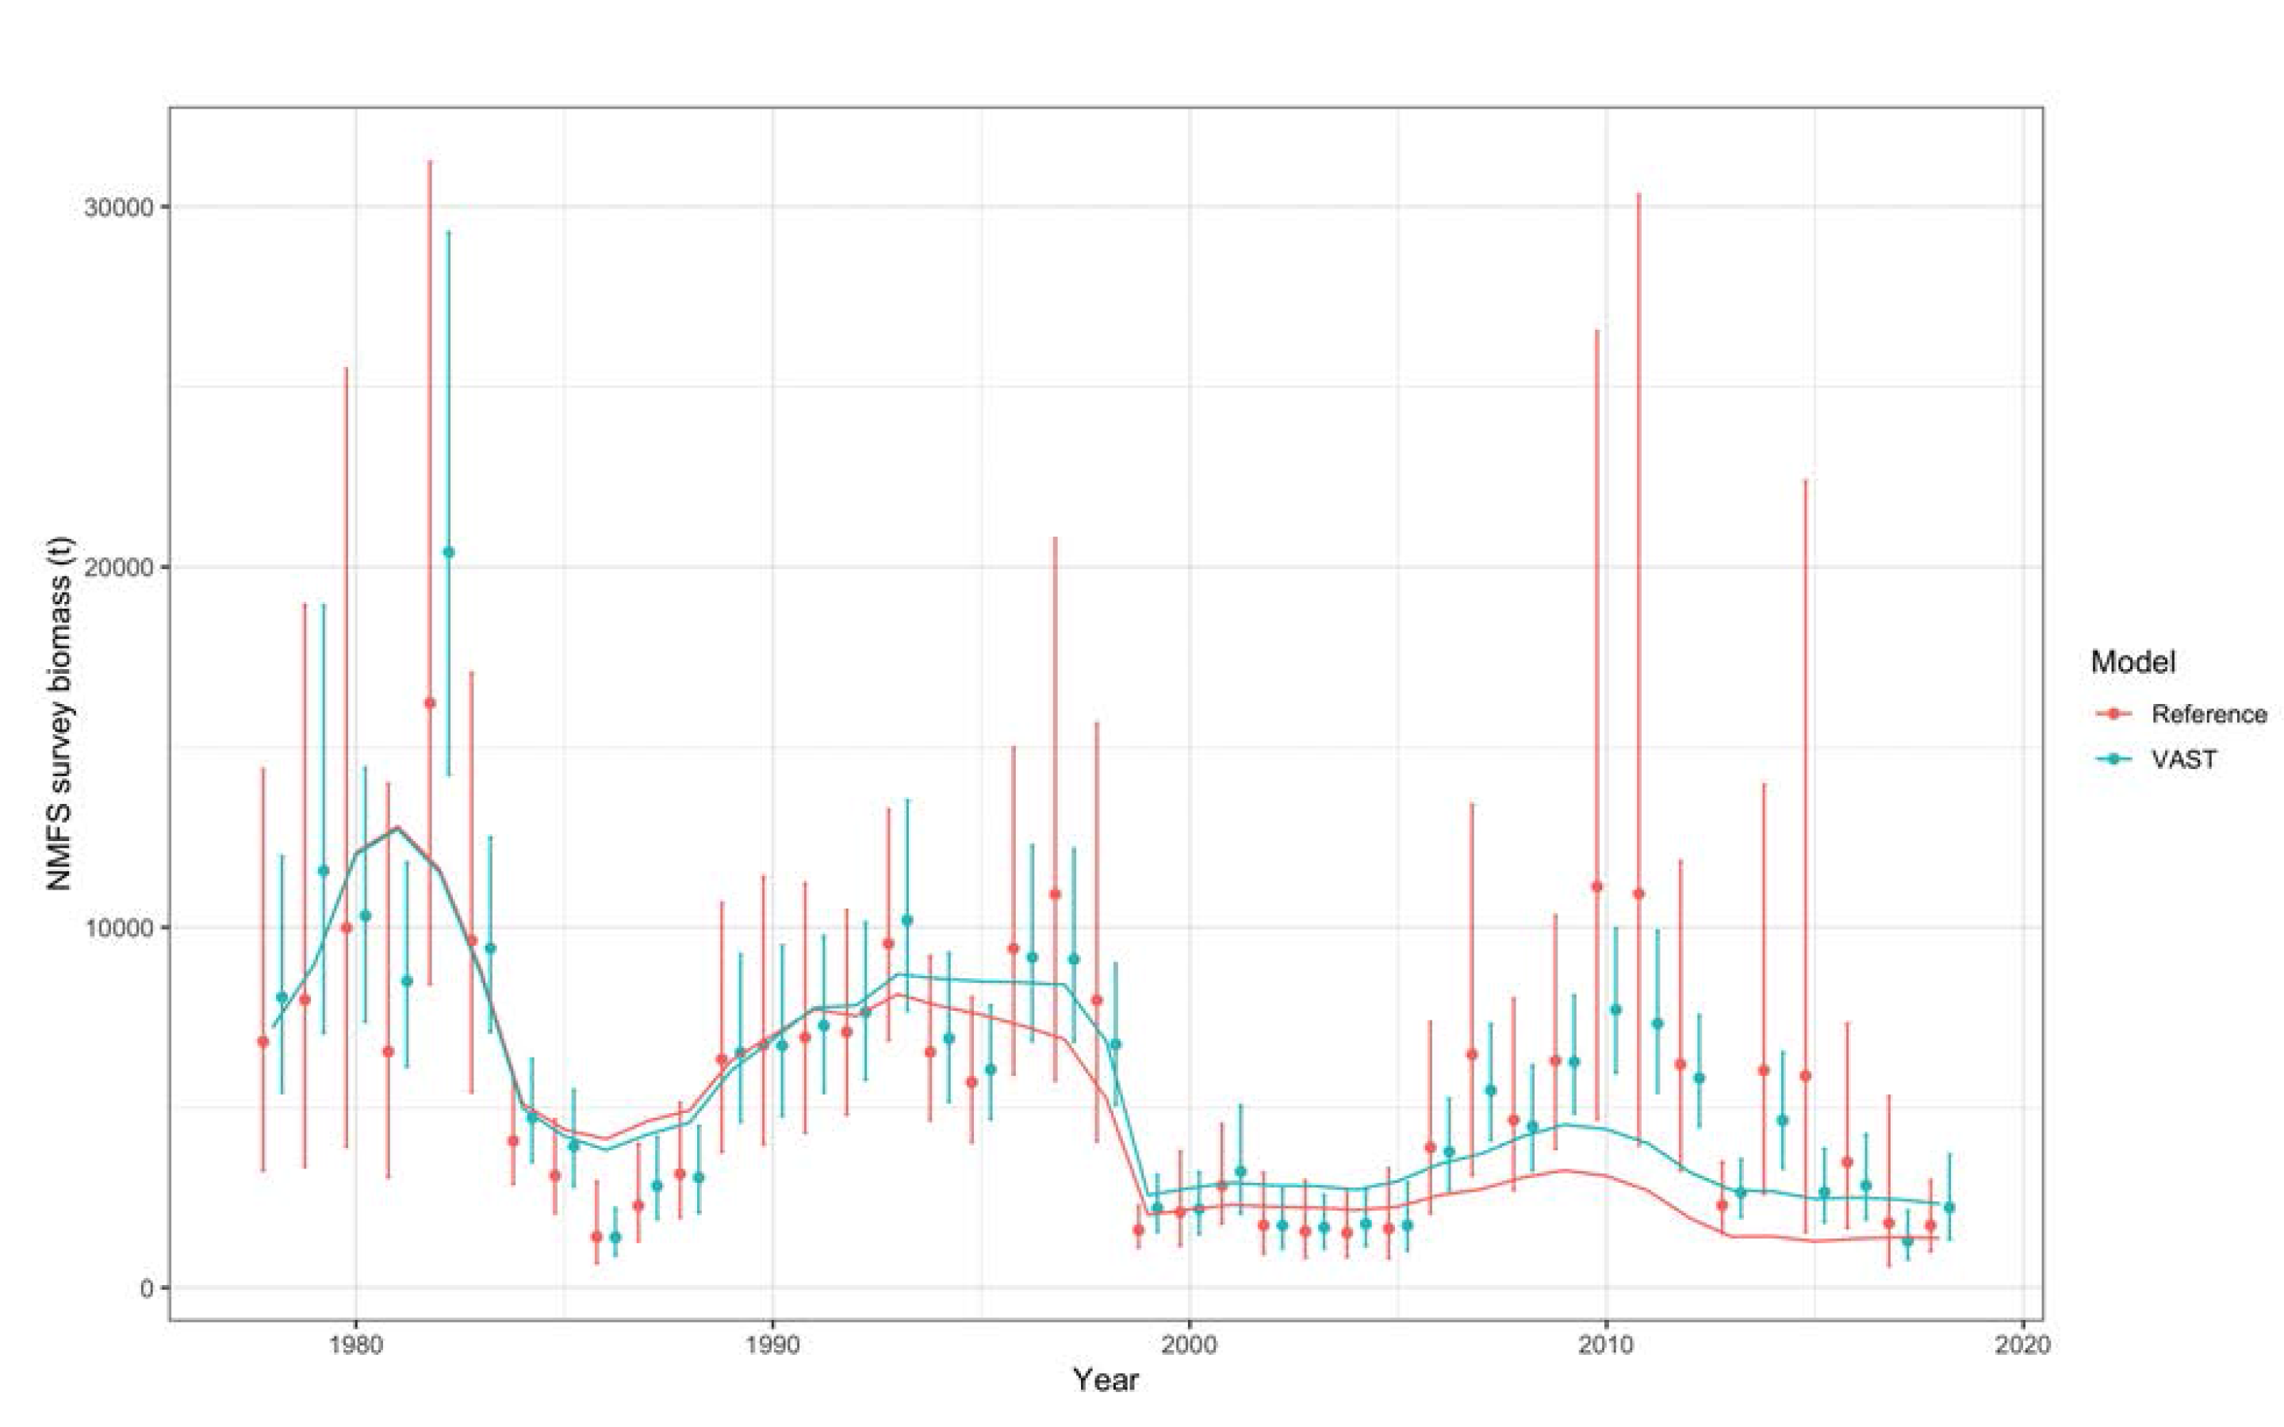
Sensitivity to index series

Slide 13
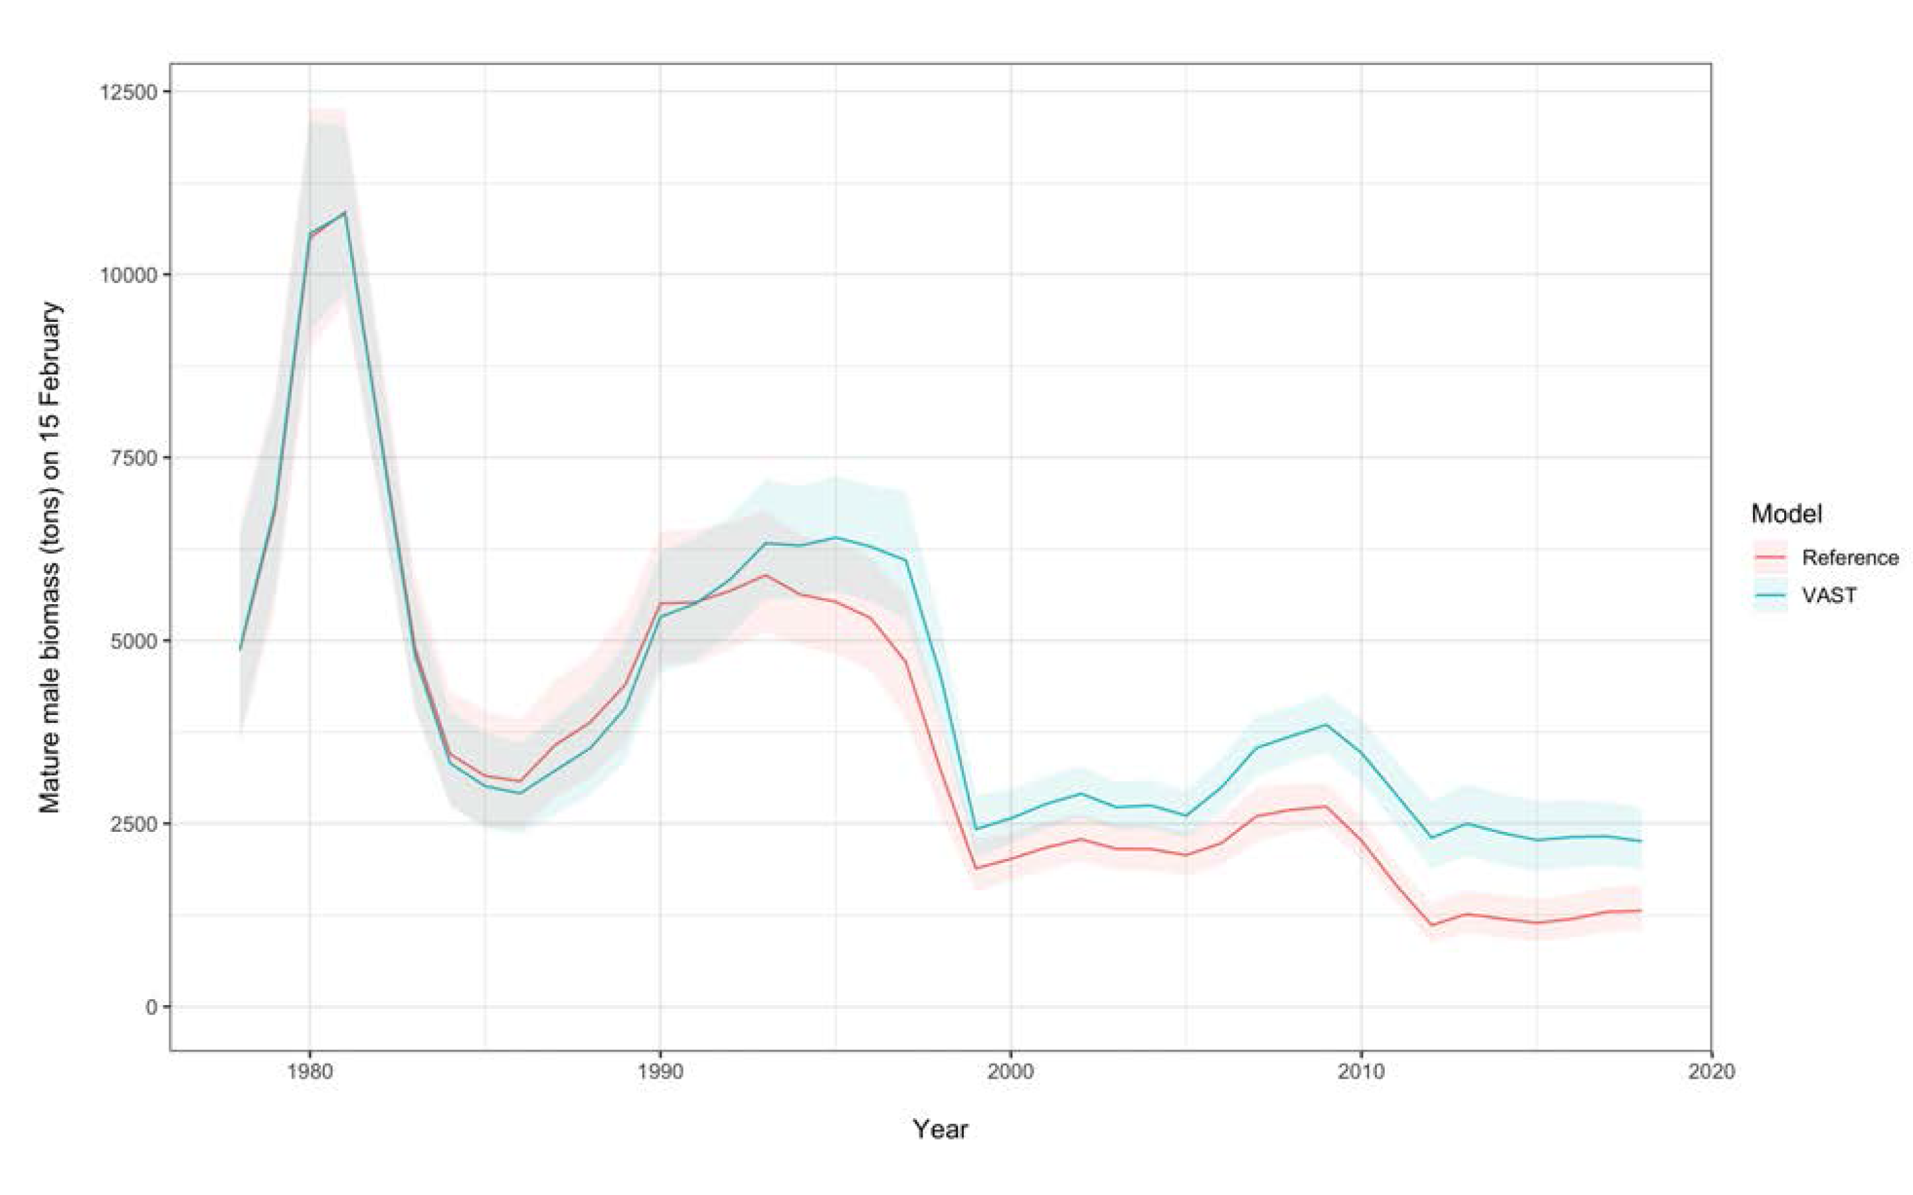
Sensitivity to index series

Slide 14
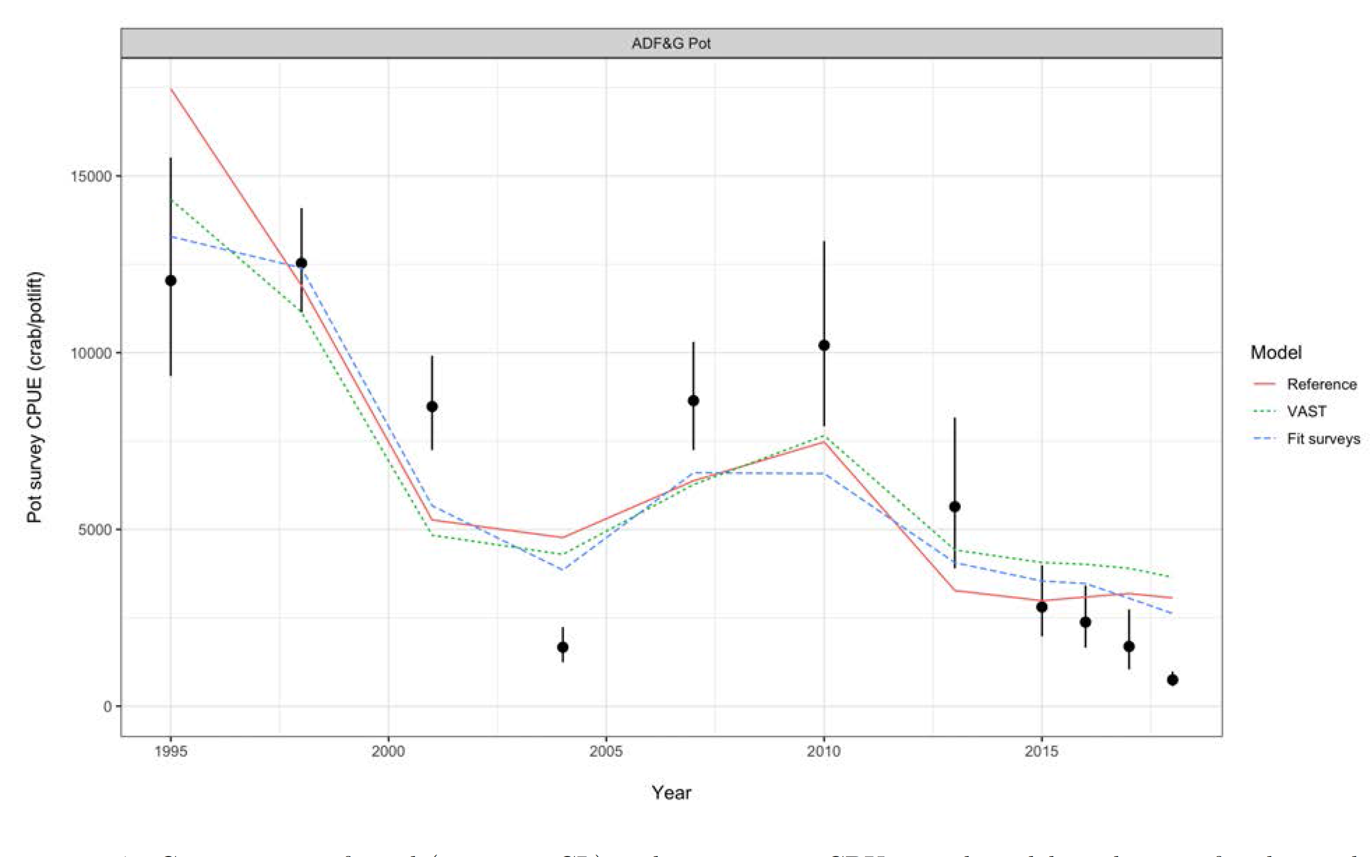
ADFG Survey fits for 3 models

Slide 15
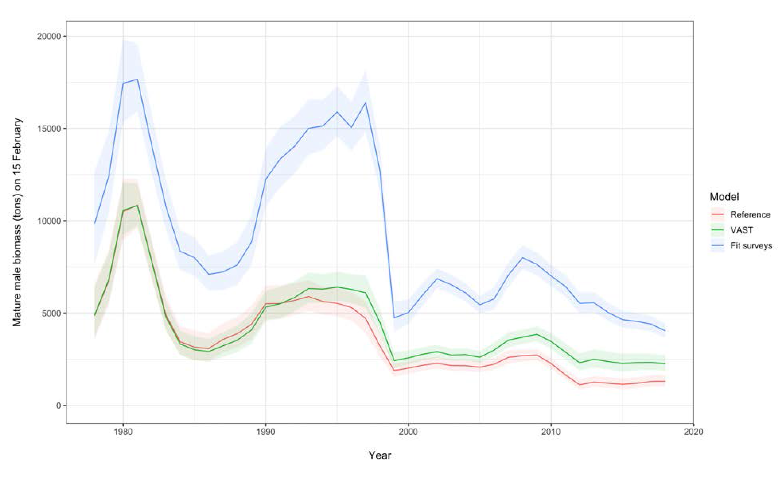
Mature male biomass

Slide 16
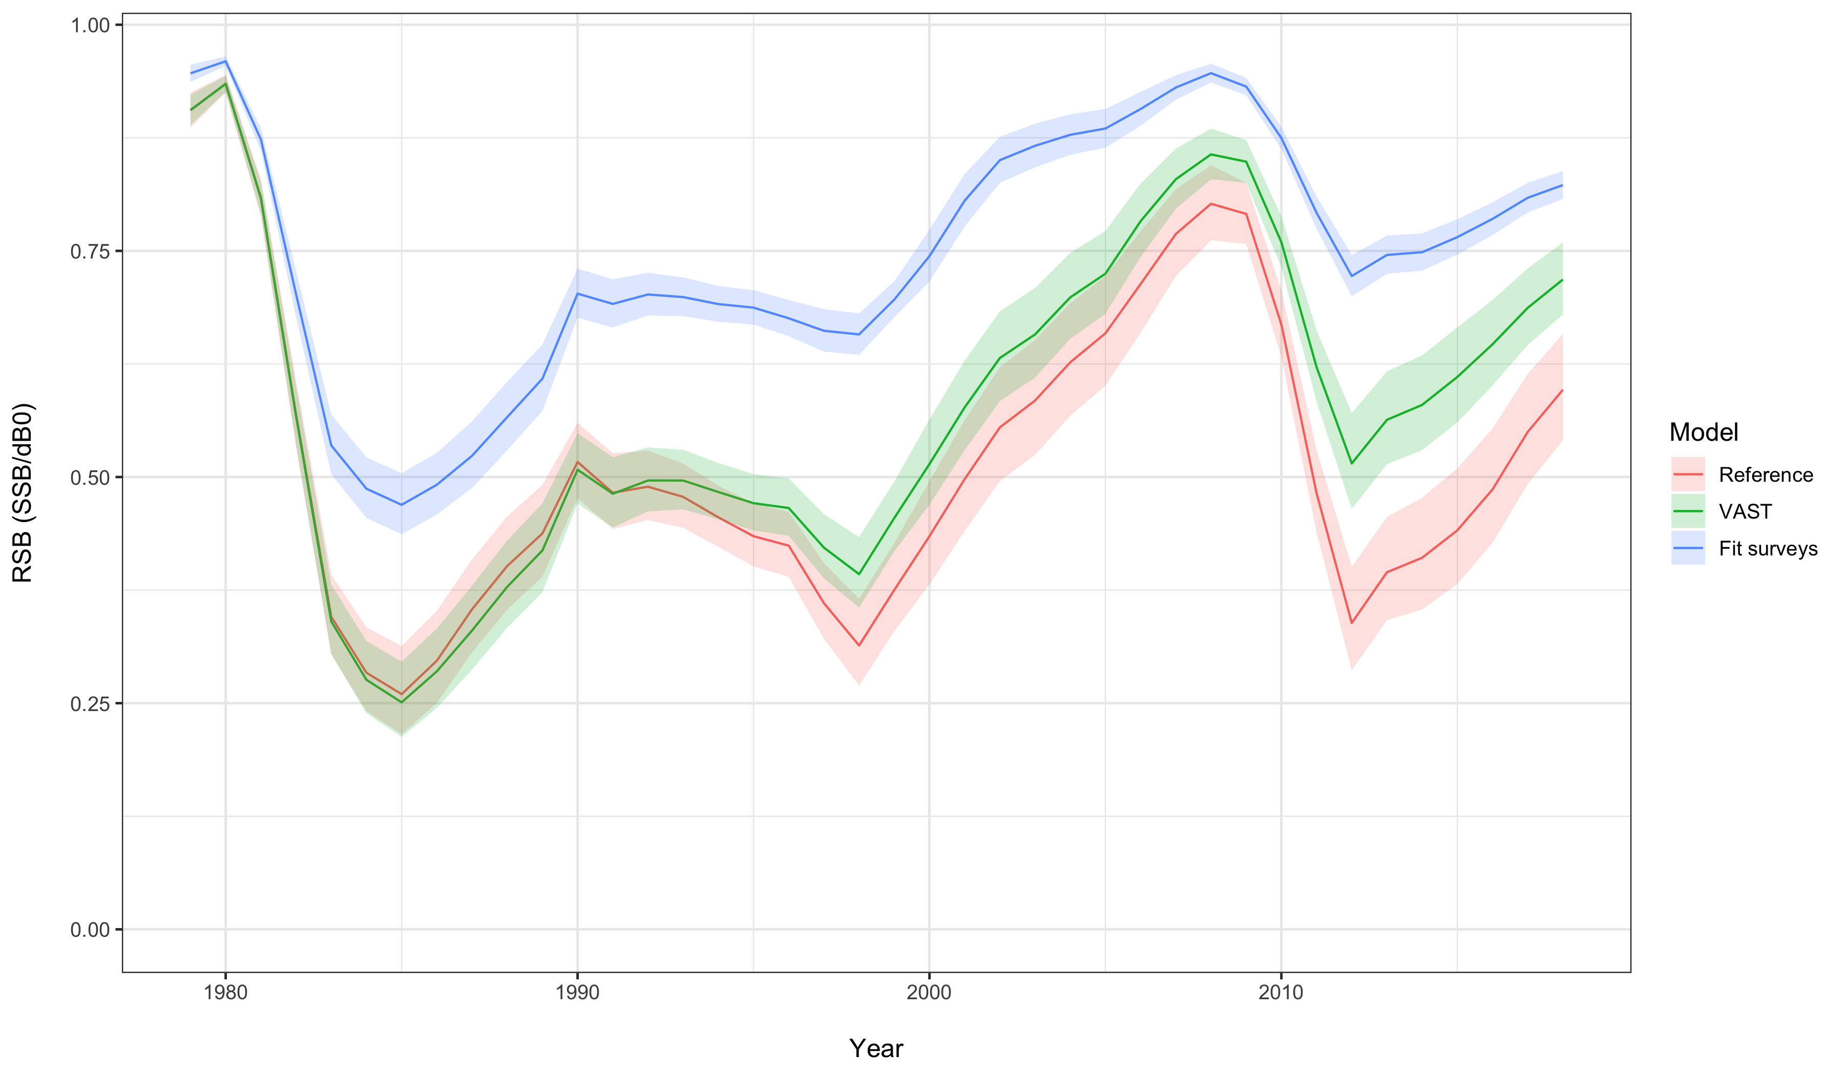
Dynamic B₀

Slide 17
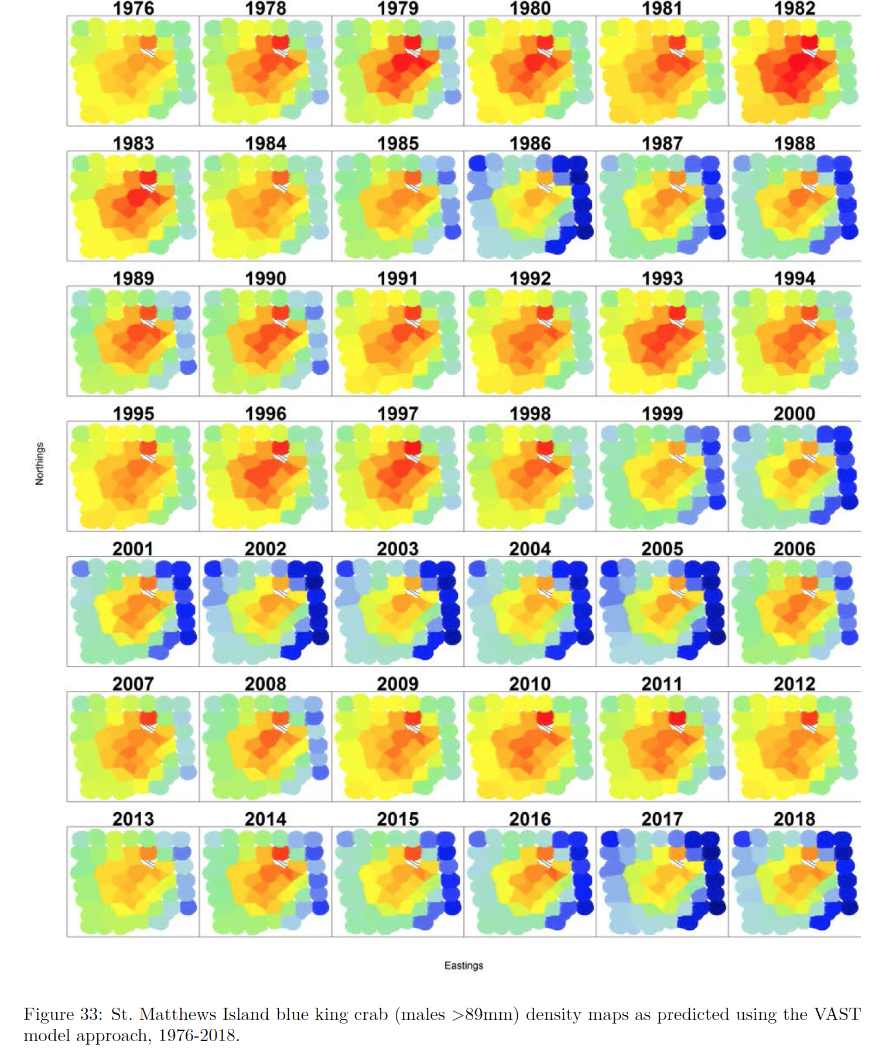
VAST
Appendix C
Applied to NMFS trawl data only

Slide 18
VAST alternative survey index
Precedence w/ WC and other fish stock applications
Residuals and diagnostics good
Scale issue a concern

